Slide 1

Online Ride Services (ORS)
CSCI 595-Research Lit and Techniques
Department of Computer Science
Texas A&M University - Commerce
Submitted by: Instructor:
Mohammed Safian Syed (50136688) Dr. Hamid Azzo
Aditya Prasanna Handadi (50135737)
Santosh Kunwar (50096459)
Aug 4 2015

Slide 2
Problems:
Limited/No public transport
High fare for cab service
FACTS:
45% of American households lack any access to public transit.
Traffic Congestion Costs Americans $124 Billion A Year
Use of gasoline in vehicles resulted in 31% of CO₂ in US.
SOLUTION:
1. Wait till public transportation infrastructure is improved.
2. Share ride with others.
Notes:
http://www.infrastructurereportcard.org/transit/- 45%
http://www.forbes.com/sites/federicoguerrini/2014/10/14/traffic-congestion-costs-americans-124-billion-a-year-report-says/

Slide 3
Existing Ride Share services : UBER , Lyft
Limitations:
Limited to major cities like NY, DC, LA, San Antonio
Expensive
Not accessible without Smartphone and credit card.
Our System:
Available anywhere once hosted
Cheaper than alternatives
Everybody with access to internet can use with ease
Faster and Reliable Google Maps
Easy Login
Share A Ride
Search A Ride
Advance Book
Email Notifications

Slide 4
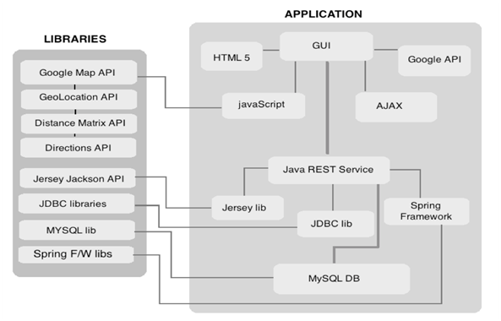
Overall System Architecture
Google Map API
Finding your location
Distance between 2 points
Drawing Route
Client Server API
Jersey Servlets
Jackson JSON parsing
JDBC API
Server to Database

Slide 5
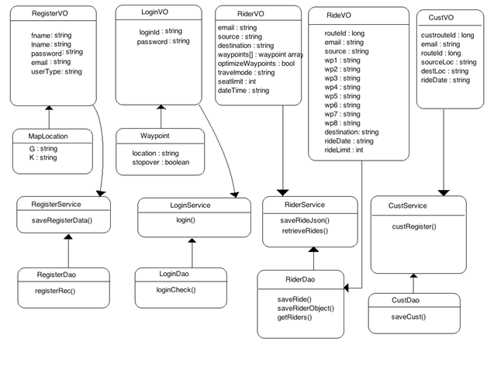
Class Diagram

Slide 6
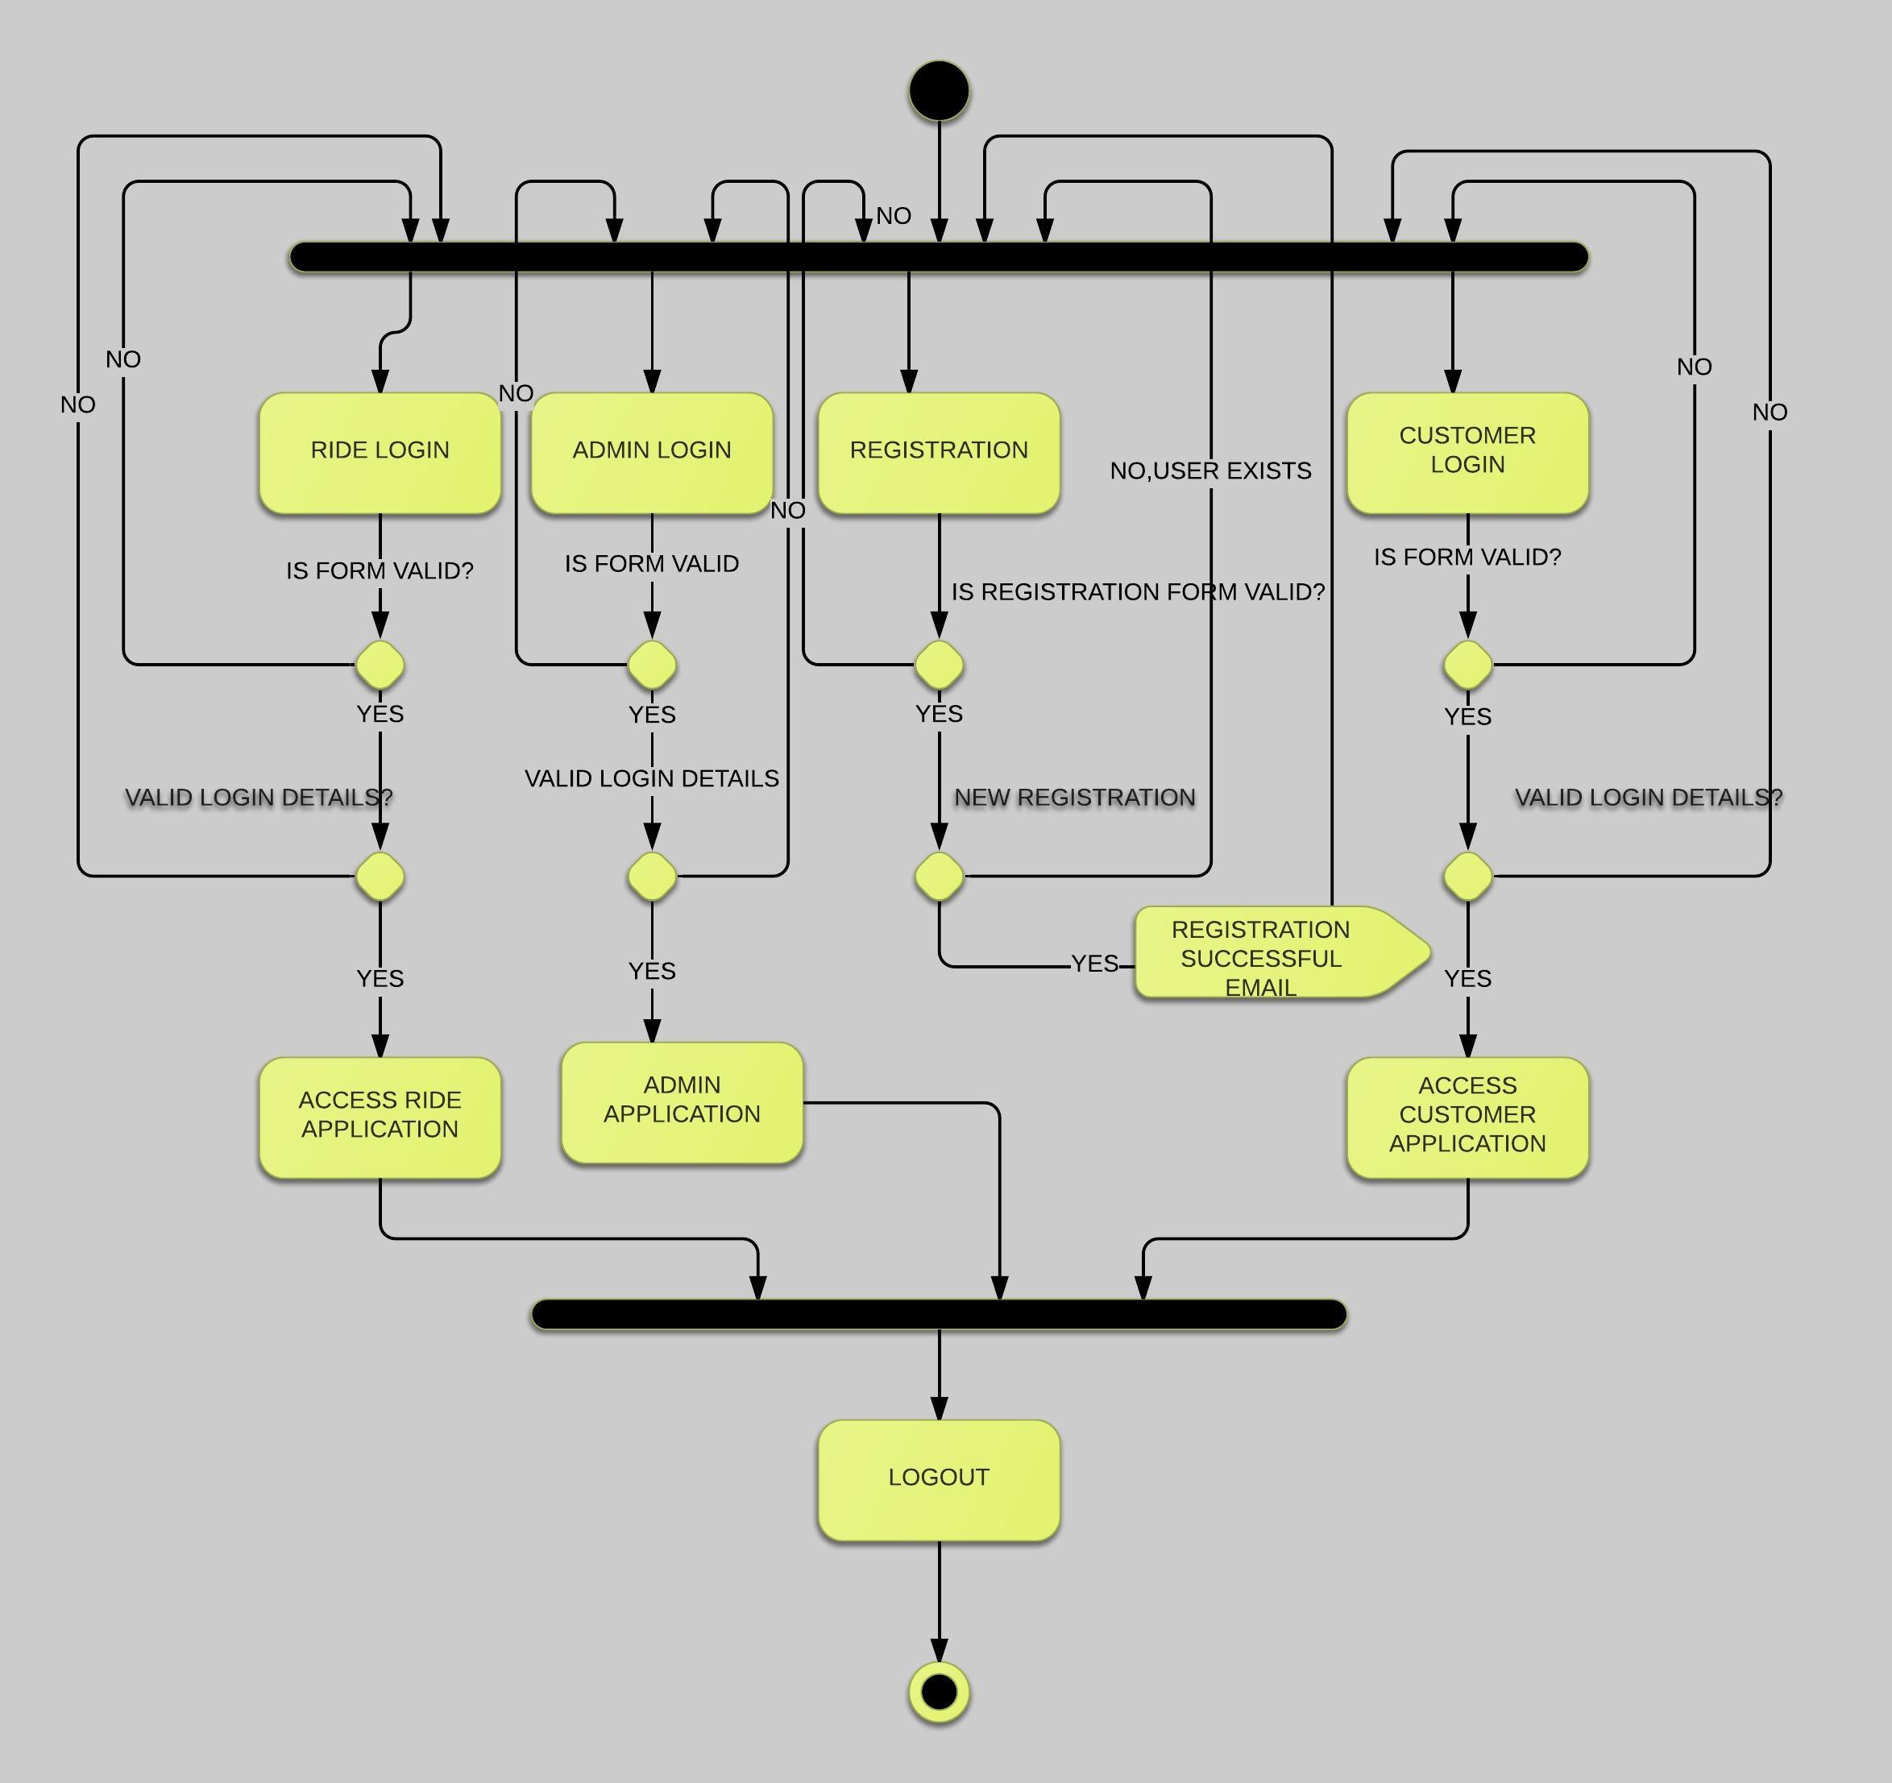
Login Activity Diagram
Register , if you are new user
Existing User’s can login
If you are offering Ride, Ride Login
If you are searching, Customer Login

Slide 7
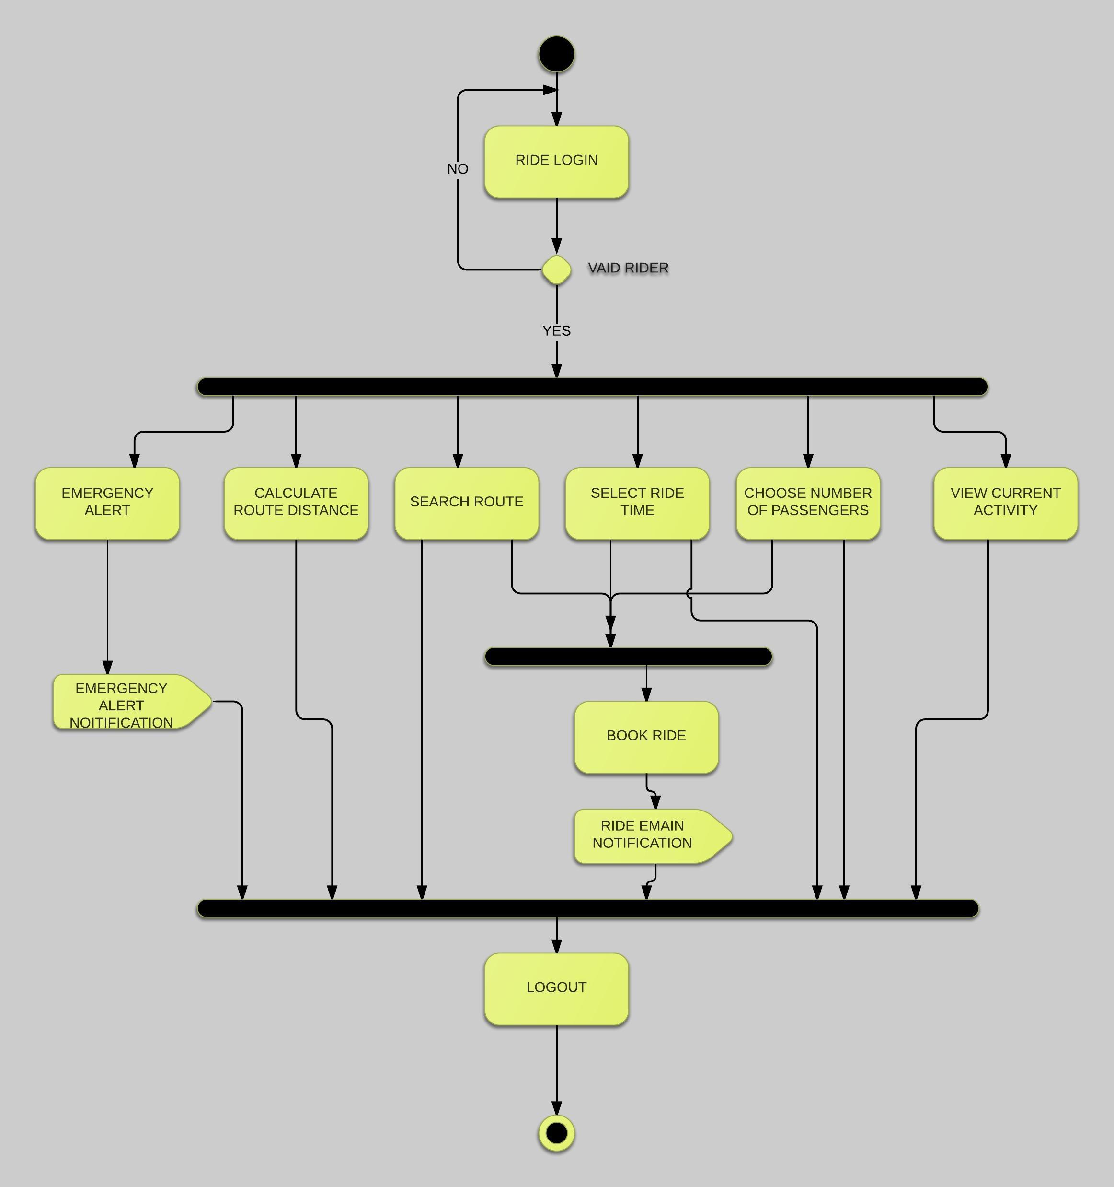
Ride Activity Diagram
Select Source and Destination
Select when you want to
offer the ride
Make your custom route
Get e-Mail Confirmation

Slide 8
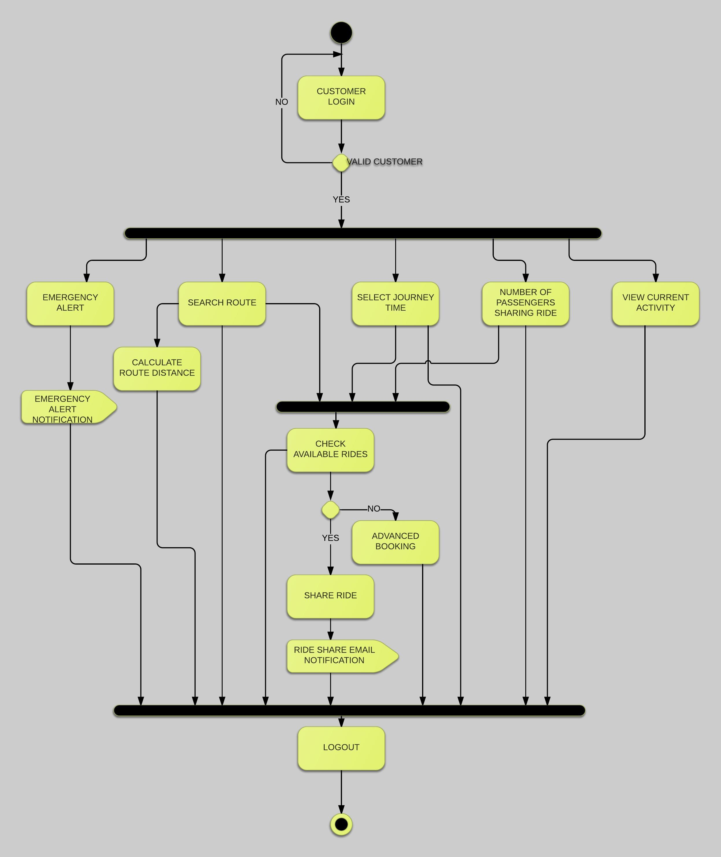
Customer Activity Diagram
Search Rides made easy
Find multiple available rides
Choose the route that
best suites you
No ride found?
You can advance book
We will notify you if any rides found

Slide 9
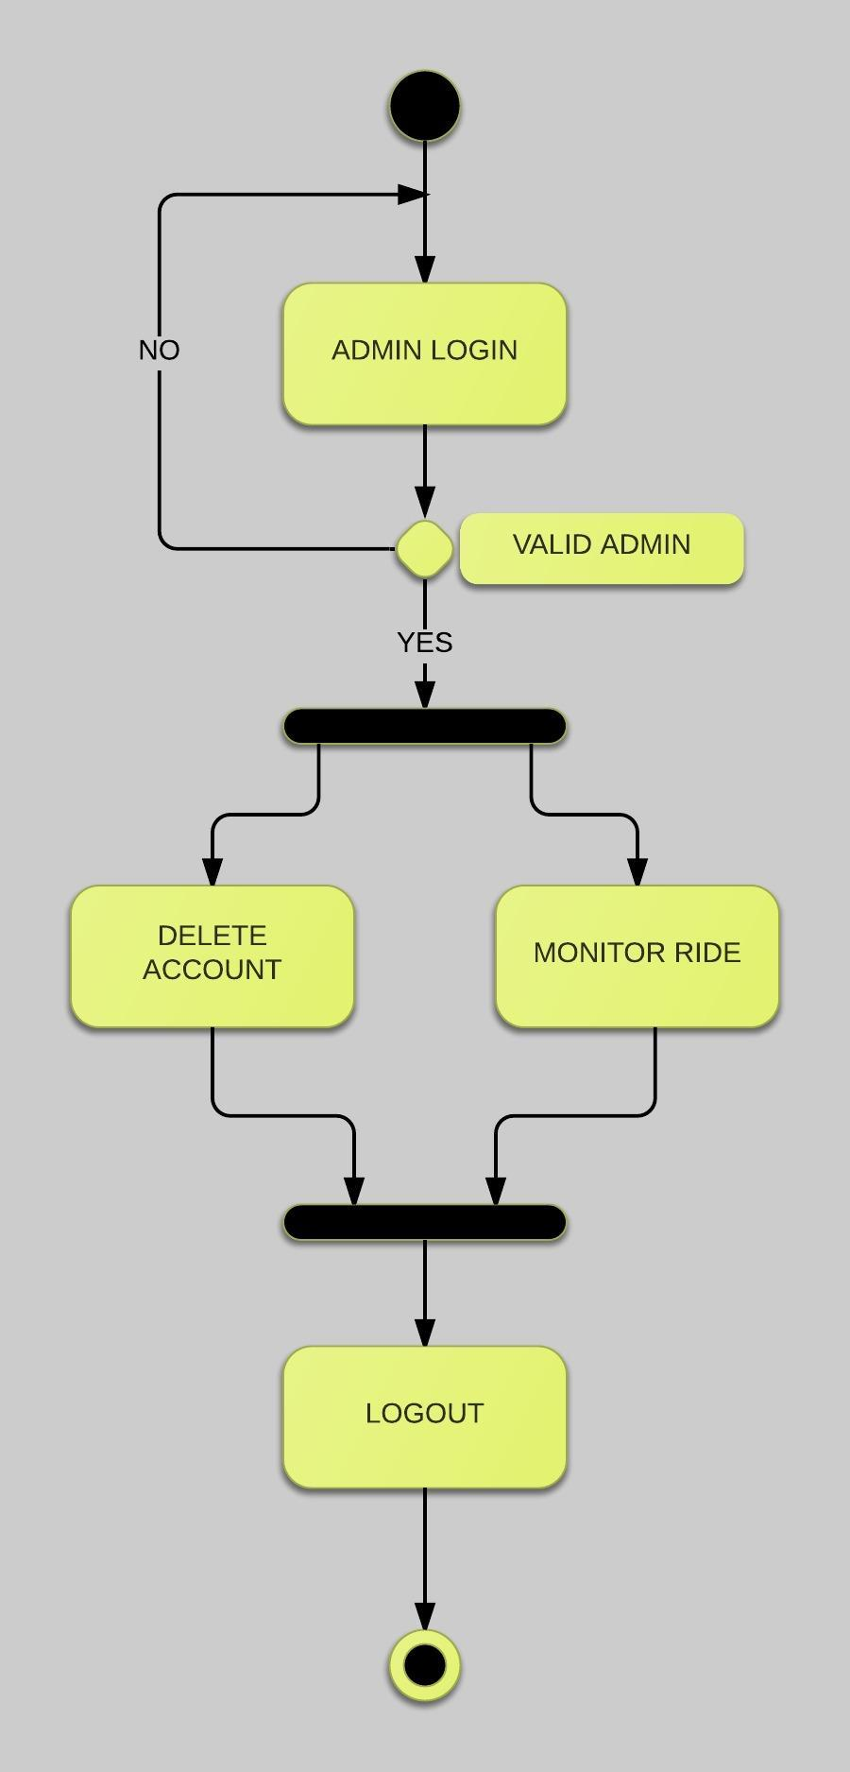
Admin Activity Diagram
Delete Routes
Monitor Rides

Slide 10
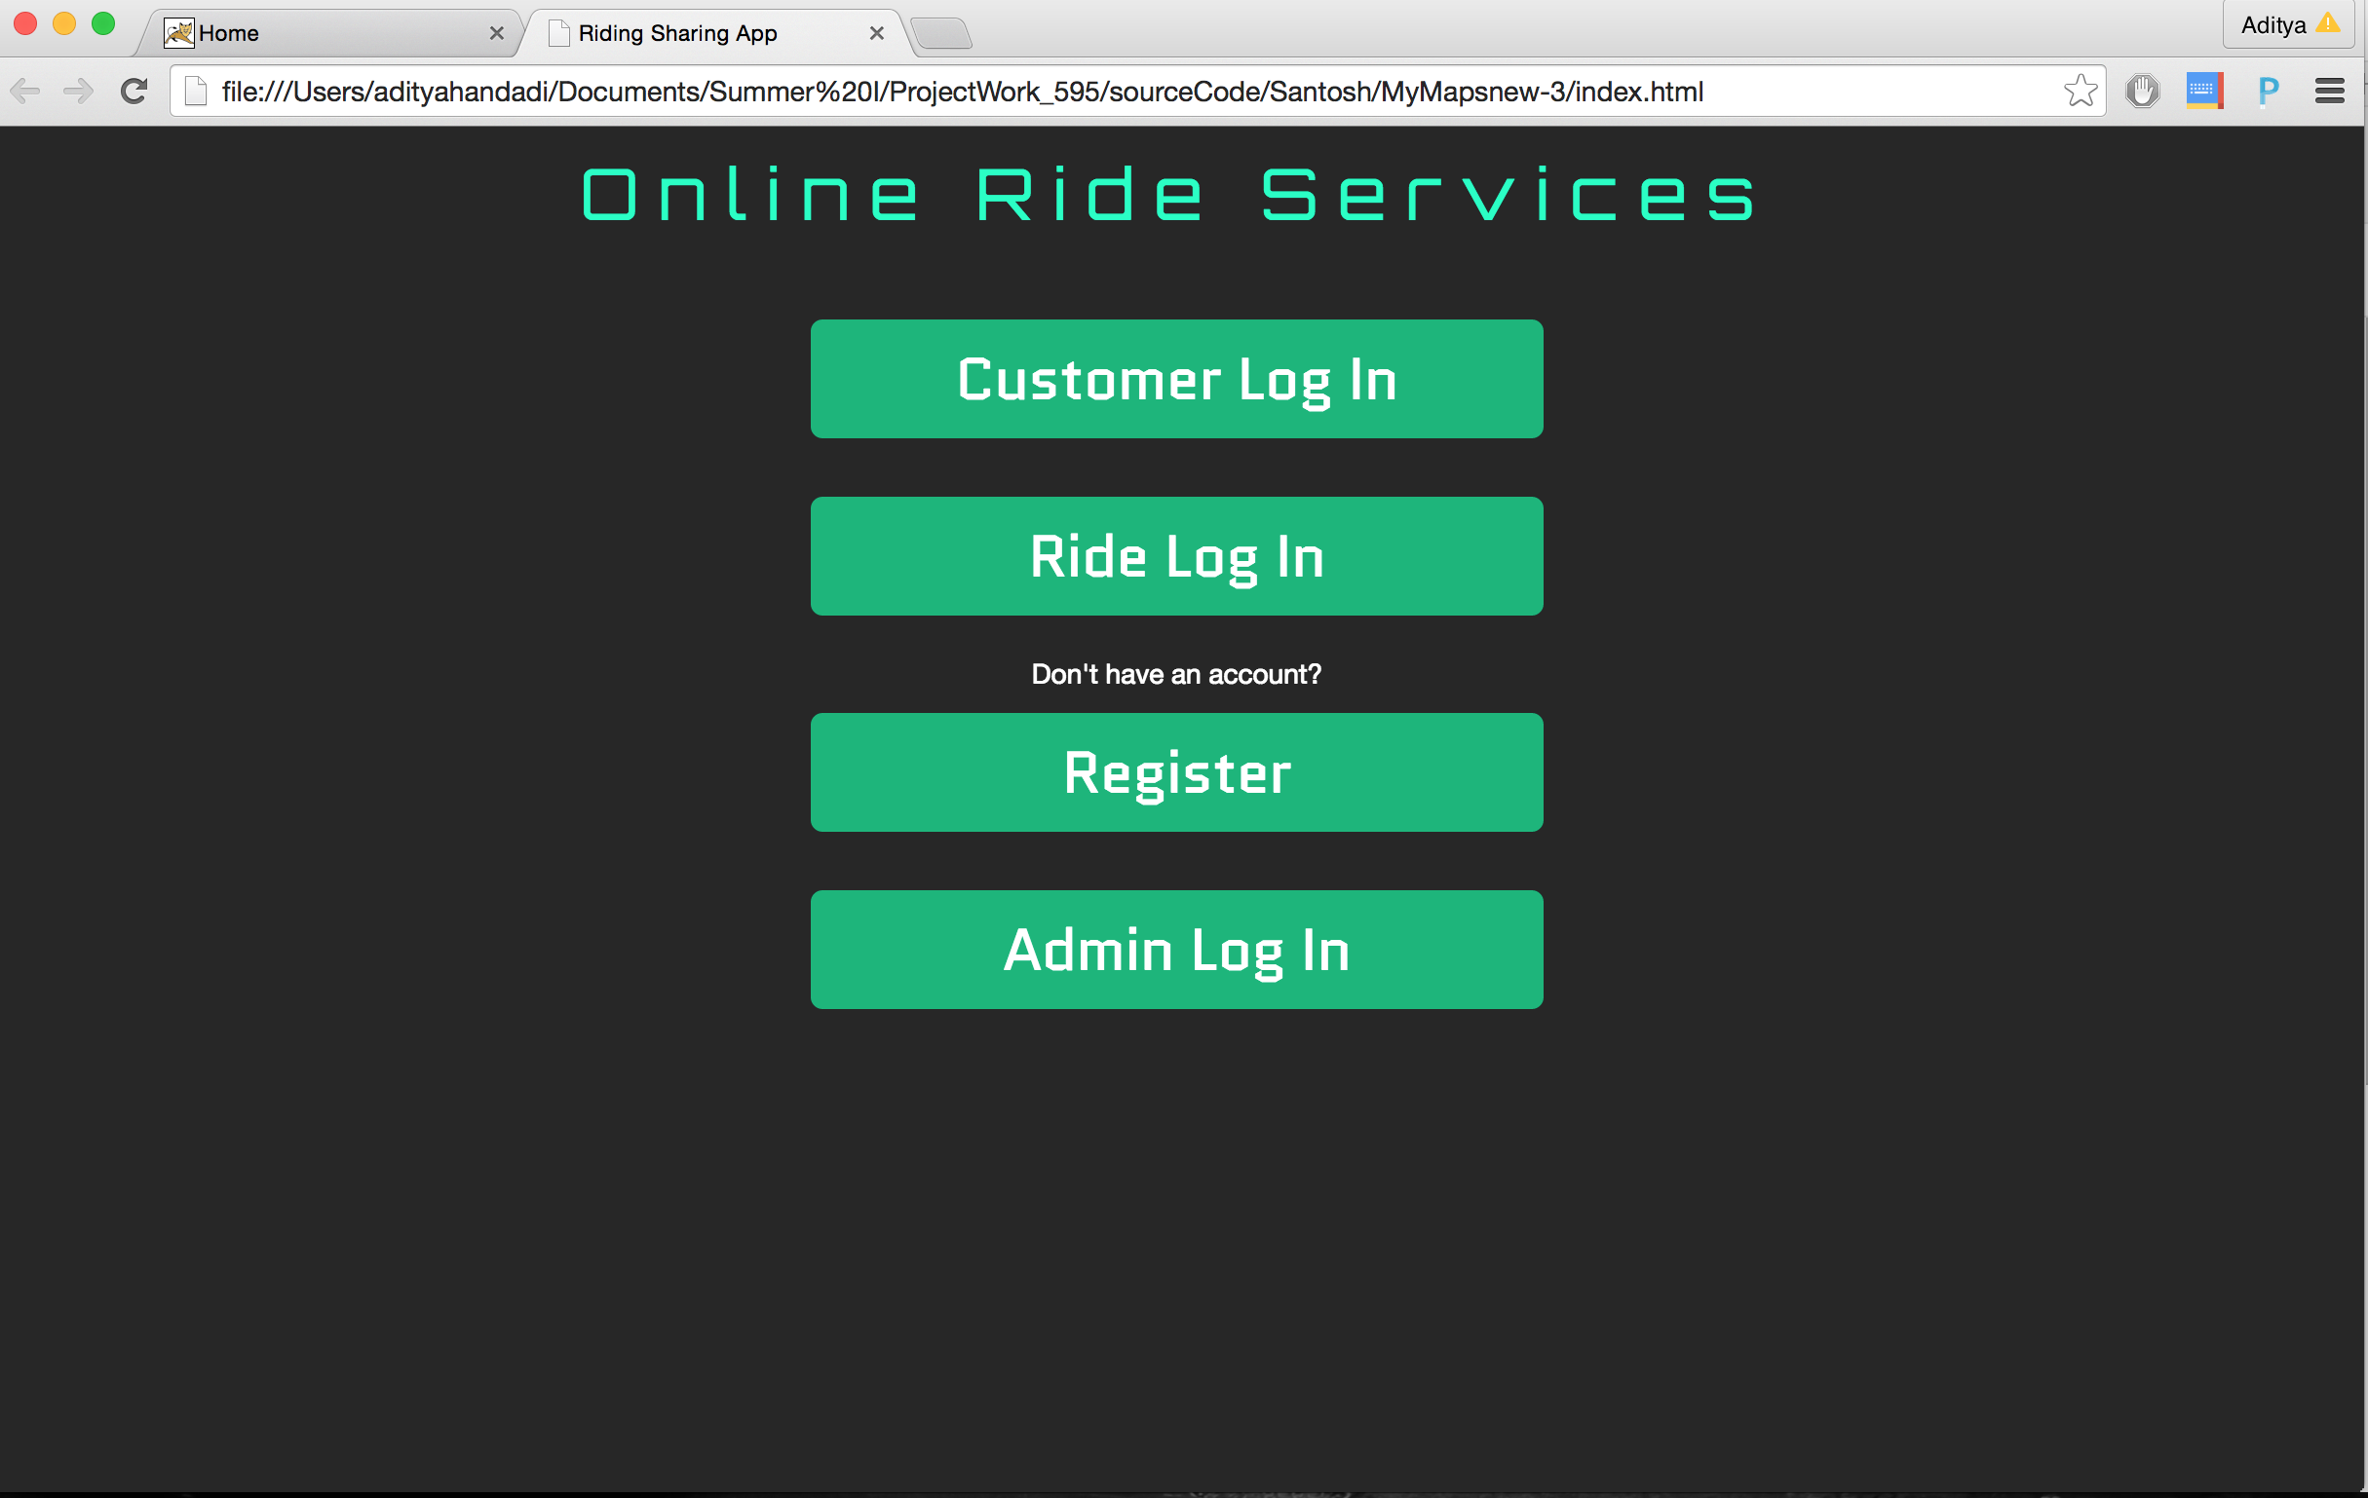
If you looking for
a ride
If you are offering
a ride
new user

Slide 11
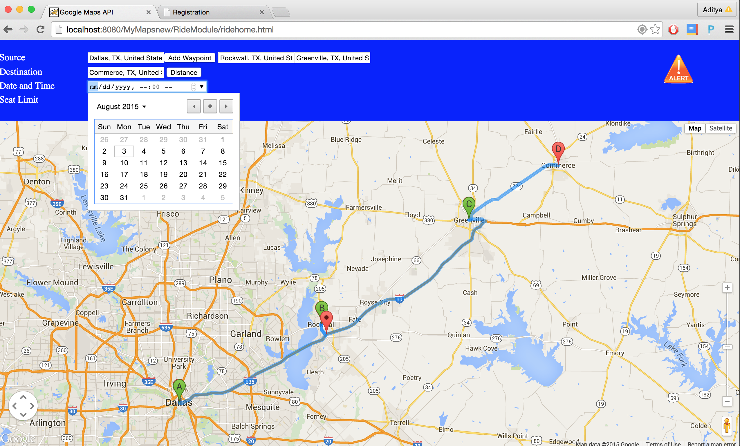
Register Ride
source
route
destination
Your route on map
Choose your route
Offer Ride Anytime

Slide 12
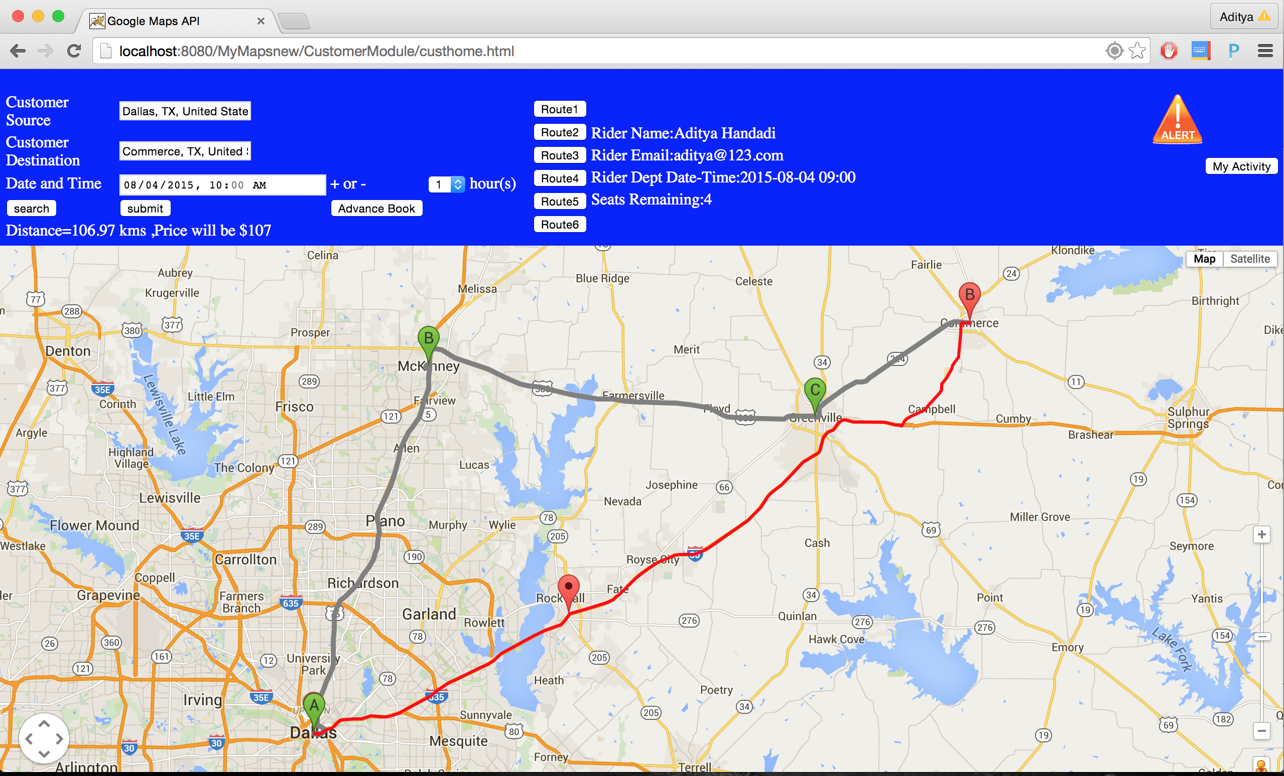
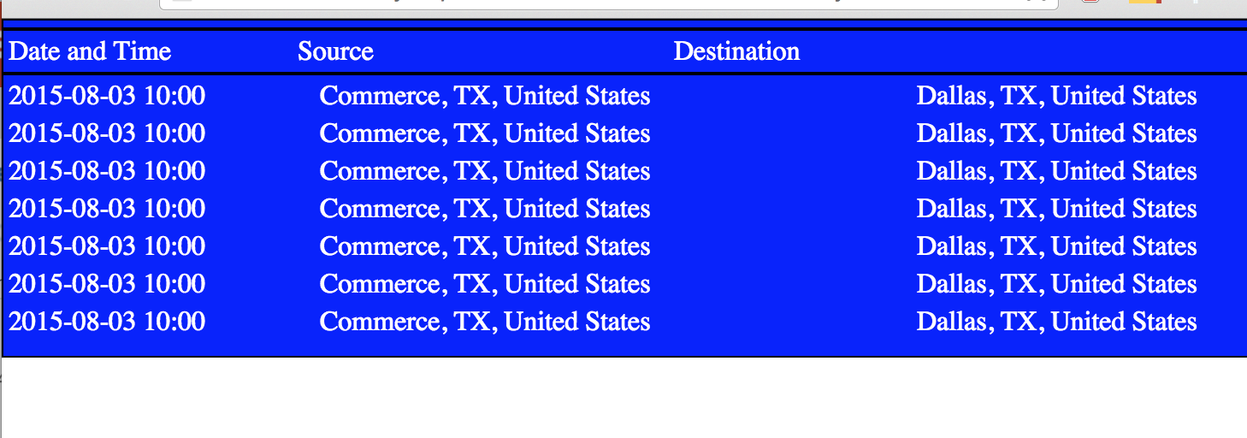
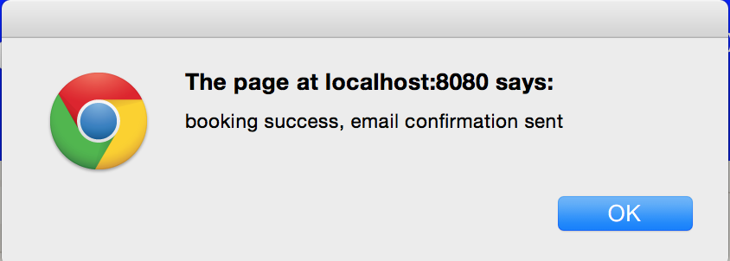
Customer Module
Emergency Notify
source
available routes
destination
Activity
If no routes available
when?
search
Selected
route
Find suitable route
Easy search
Your default route
Book advance

Slide 13
THANK YOU!!!!

